Slide 1
Spatial weights matrix Spatial statistics
Dr hab. Katarzyna Kopczewska, prof.ucz.
Faculty of Economic Sciences University of Warsaw

Slide 2
What for do we need the spatial weights matrix?
It is to incorporate spatial dependence into the model - always a question „how”:
What are a good criteria to define closeness in space
Which other units should be treated as neighbours (who influence given location)
Should W be selected a priori ? – then it is about the assumption on the nature of links
Should W be derived from the data and tested ? – then it plays the role of the filter

Slide 3
Functions of W
Spatial weights matrix W
Different criteria of neighbourhood and the strength of the links
It indicates the relative location of units (with regard to each other) – the structure of neighbourhood
assigned weights are to measure the intensity of the relationship among spatial units
Allows for computing „spatial lag” – average of values in neighbourhood
It is used in calculations of spatial statistics and estimation of models
It is crucial in measuring the externalities
It may be symmetric, but not necessarily

Slide 4
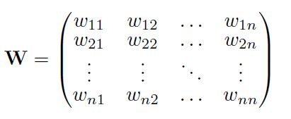
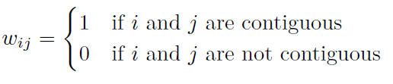
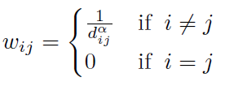

W construction
Spatial weights matrix W
size: n × n,
diagonal w_{ii} =0
it may be symmetric, but not necessarily
wij - weights for each pair of locations; result from a rule on neighbourhood structure, define the existence and strength of the spatial relations among locations
For most frequently used – contiguity matrix:
For also often used inverse distance:
Also possible: negative exponential

Slide 5
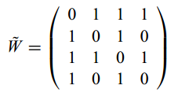
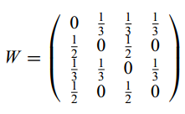
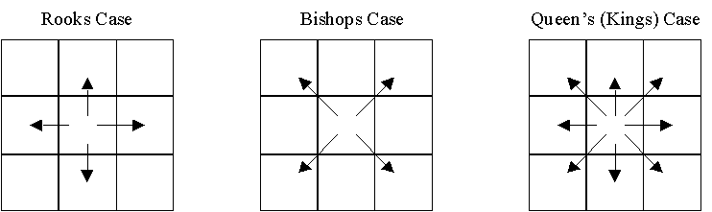
Matrix of neighbourhood and matrix of spatial weights
Spatial neighbourhood matrix
Spatial weights matrix
Spatial relation of areas, different criteria possible*, binary structure of neighbourhood
contiguity (share the border)
K nearest neighbours
within the radius of d km (great circle)
all with all other regions, but of inverse distance
Strength of spatial relations - binary structure changed to weights:
w_{ij}=1/n for n neighbours (row-standardised matrix to one
w_{ij}=1/dist_{ij} for inverse distance
* Literature also offers for regular shapes other criteria: rook (common border), bishop (common vertex), queen (either common border or vertex)

Slide 6
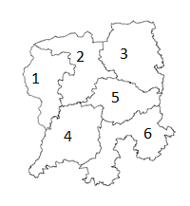
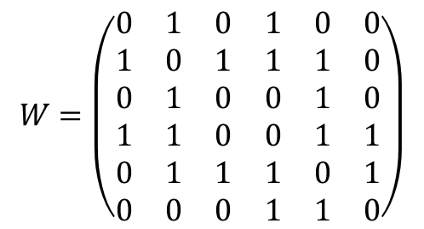
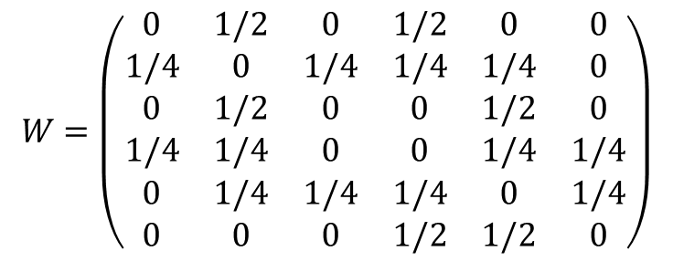
Example of W (1)
Neighbourhood structure
$$W=\left(\begin{matrix}0 & 1 & 0 & 1 & 0 & 0 \\ 1 & 0 & 1 & 1 & 1 & 0 \\ 0 & 1 & 0 & 0 & 1 & 0 \\ 1 & 1 & 0 & 0 & 1 & 1 \\ 0 & 1 & 1 & 1 & 0 & 1 \\ 0 & 0 & 0 & 1 & 1 & 0\end{matrix}\right)$$
Matrix of spatial weights
$$W=\left(\begin{matrix}0 & 1/2 & 0 & 1/2 & 0 & 0 \\ 1/4 & 0 & 1/4 & 1/4 & 1/4 & 0 \\ 0 & 1/2 & 0 & 0 & 1/2 & 0 \\ 1/4 & 1/4 & 0 & 0 & 1/4 & 1/4 \\ 0 & 1/4 & 1/4 & 1/4 & 0 & 1/4 \\ 0 & 0 & 0 & 1/2 & 1/2 & 0\end{matrix}\right)$$

Slide 7
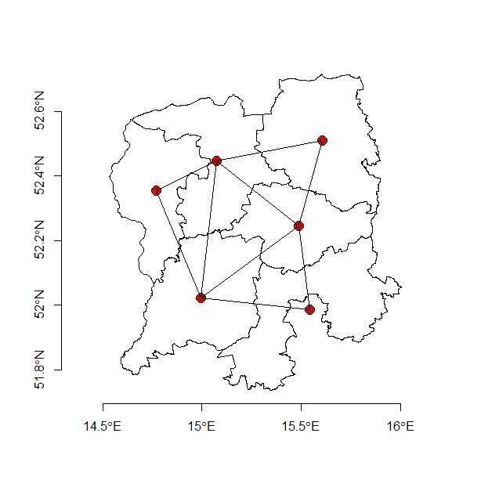
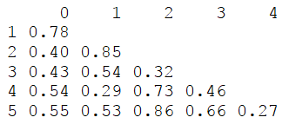
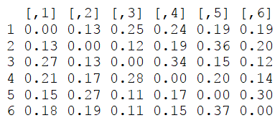
Example of W (2)
Distances between regions
EG8-MAX-DLDD
EG8-MAX-DLDD
Inverse distance matrix
Distances calculated bewteen centroids (usually Euclidean distance)

Slide 8
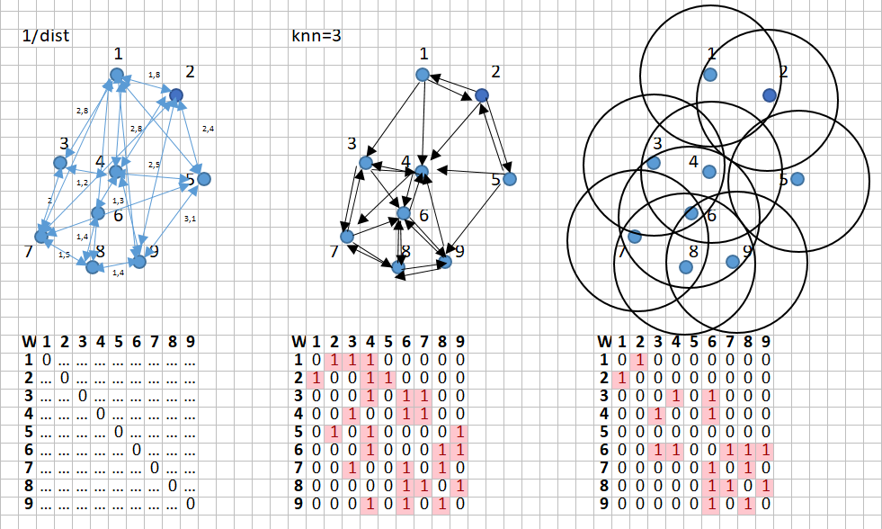
Summary of W

Slide 9
Summary of terms
W – spatial weights matrix, transformed neighbourhood matrix
Spatial lag – average of values in neighbourhood
one adds spatial lags of y, x and e into models
Spatial autocorrelation – relation between observation in location i and observation in location j
Spillover effects – Direct impact ∆X(i) → ∆Y(i) and indirect impact ∆X(i) → ∆Y(j)

Slide 10
Exploratory Spatial Data Analysis (ESDA)
ESDA - Exploratory Spatial Data Analysis → to find structure (cluster, unusual observations) in large and not necessarily homogeneous spatial data sets
Global measures (one value for whole dataset)
Moran’s I (1950) (more sensitive to outliers)
Geary’s C (1954) (more sensitive to local autocorrelation)
Getis-Ord’s G (1992)
Global spatial autocorrelation (spatial dependence): positive autocorrelation means that locations close to each other exhibit more similar values than those further apart. High (low) values are sistematically surrounded by high (low) values. This should be true for the whole territory.
Local measures - LISA – Local Indicator of Spatial Association (separate values for each spatial unit)
Local Moran’s I (Anselin 1995)
Local Geary’s C (Anselin 1995)
Local G* (Getis and Ord, 1995)
Local spatial autocorrelation: if spatial relation does not occur systematically (no global spatial dependence) we can look for some local patterns, which are typical for some clusters only
We can also get Moran Scatterplot and maps of LISA

Slide 11
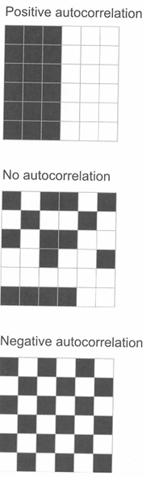
Spatial autocorrelation (1)
Spatial autocorrelation
Similar values neighbouring more often than in random distribution, when extreme then club or spatial heterogenity
When no clear spatial pattern is visible
When similar values touch similar values more rarely then in random distribution

Slide 12
What does spatial autocorrelation mean? (1)
When tracking for spatial autocorrelation one should be aware of the consequences of this phenomenon:
Null Hypothesis: no spatial autocorrelation
Spatial randomness (vs. spatial clustering)
Values observed at a location do not depend on values observed at neighbouring locations
Observed spatial pattern of values is the same as any other spatial pattern
The location of values may be altered (spatial permutation) without affecting the information content of the data
Alternative Hypotheses: spatial dependence
Positive spatial autocorrelation: similar values tend to cluster in space (neighbours are similar)
Negative spatial autocorrelation: Neighbours are different

Slide 13
What does spatial autocorrelation mean? (2)
In case of lack of spatial randomness, there are few types of spatial association possible:
Spatial autocorrelation: similar (dissimilar) values in space tend to cluster together
Spatial heterogeneity: spatial regimes, space is not homogeneous, there may exist clubs of similar values inside, but very different from outside values

Slide 14

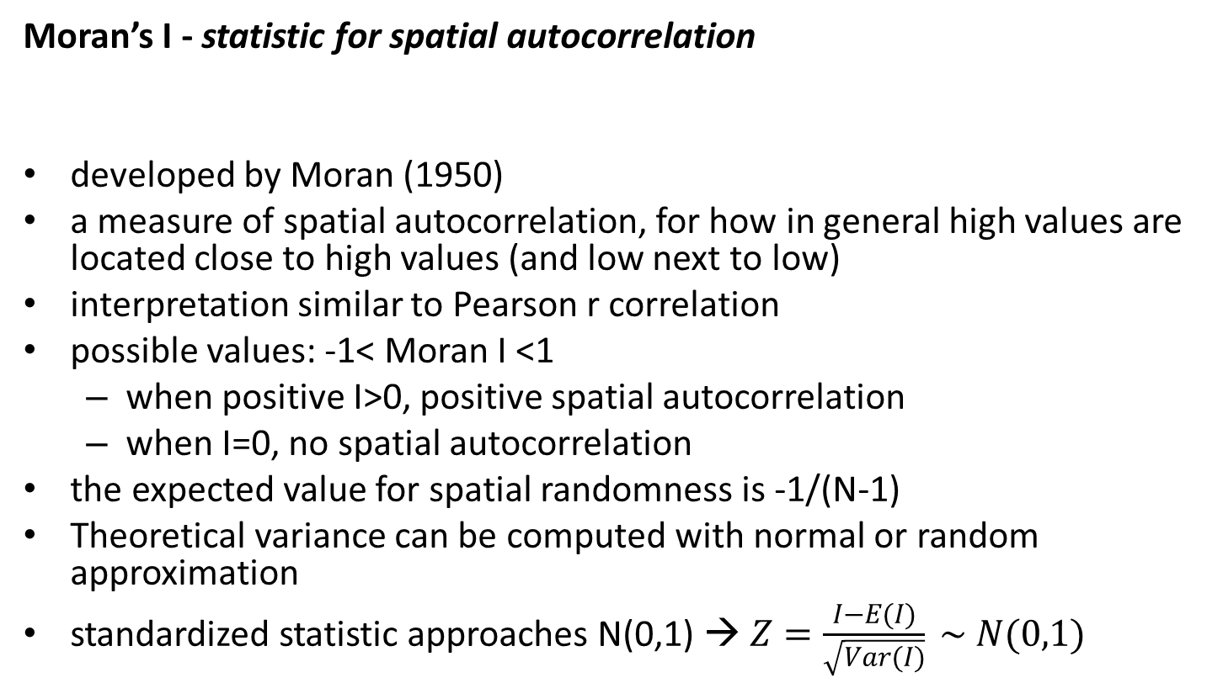
Spatial autocorrelation (2)
Moran’s I - statistic for spatial autocorrelation
developed by Moran (1950)
a measure of spatial autocorrelation, for how in general high values are located close to high values (and low next to low)
interpretation similar to Pearson r correlation
possible values: -1< Moran I <1
when positive I>0, positive spatial autocorrelation
when I=0, no spatial autocorrelation
the expected value for spatial randomness is -1/(N-1)
Theoretical variance can be computed with normal or random approximation
standardized statistic approaches N(0,1) → $Z=\frac{I−E(I)}{\sqrt{Var(I)}} \sim N(0,1)$

Slide 15
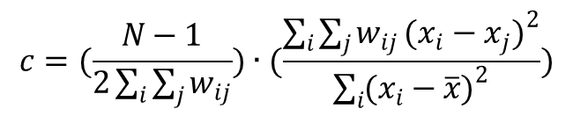
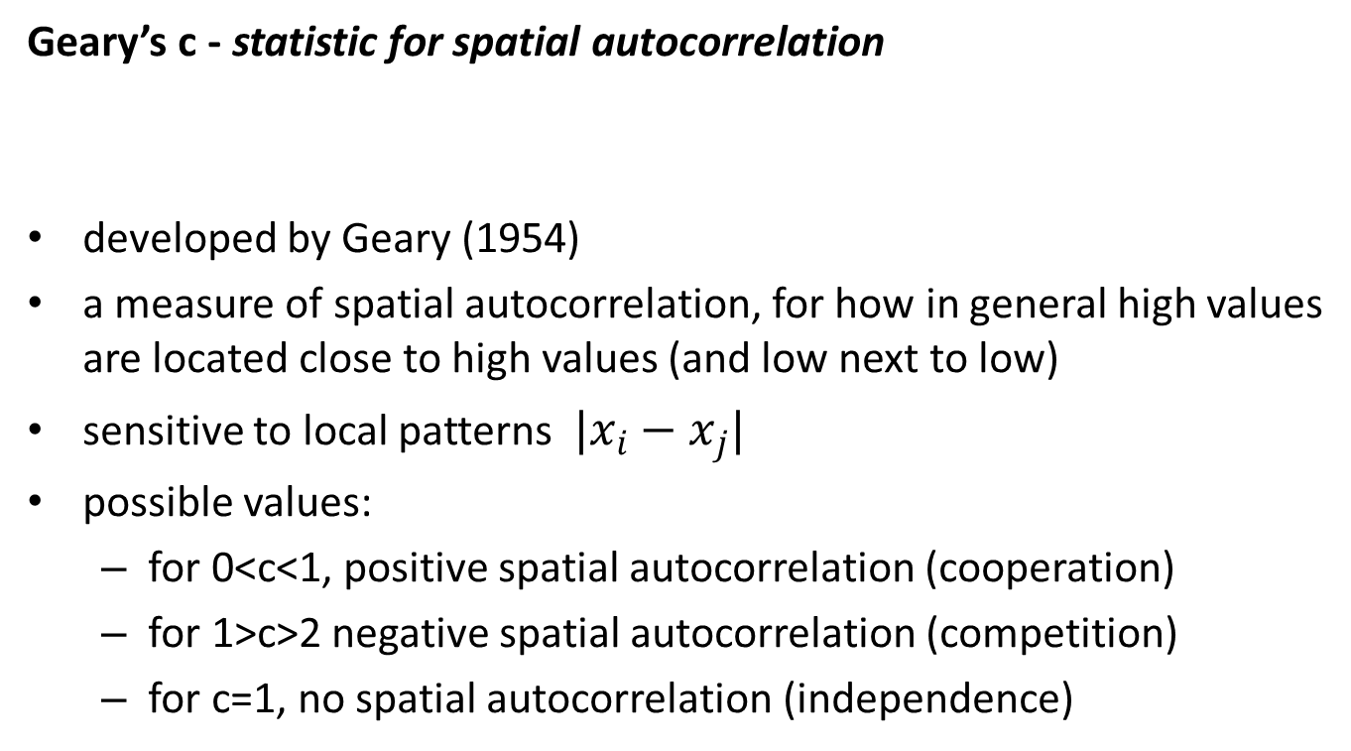
Spatial autocorrelation (3)
Geary’s c - statistic for spatial autocorrelation
developed by Geary (1954)
a measure of spatial autocorrelation, for how in general high values are located close to high values (and low next to low)
sensitive to local patterns $|x_{i}−x_{j}|$
possible values:
for 0<c<1, positive spatial autocorrelation (cooperation)
for 1>c>2 negative spatial autocorrelation (competition)
for c=1, no spatial autocorrelation (independence)
$$c=(\frac{N−1}{2\sum_{i}{\sum_{j}{w_{ij}}}})∙(\frac{\sum_{i}{\sum_{j}{w_{ij}}}({x_{i}−x_{j})}^{2}}{\sum_{i}{({x_{i}−\overline{x})}^{2}}})$$

Slide 16
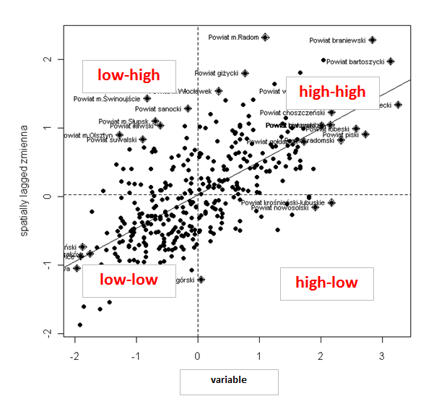
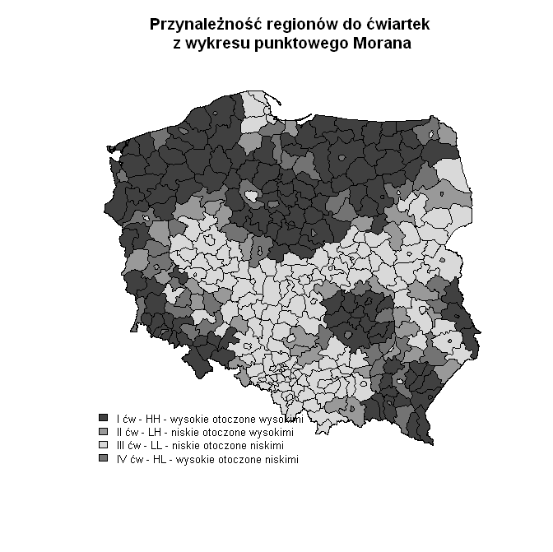
Spatial autocorrelation (3)
Moran scatterplot
X: variable of interest
Y: spatial lag of X
HH, LL – spatial clusters
HL, LH – spatial outliers
It is useful in tracking for spatial regimes
Color of region: „me vs. around”
HH (high-high) (dark colour) – me and my neighbours have high level of phenomenon

Slide 17
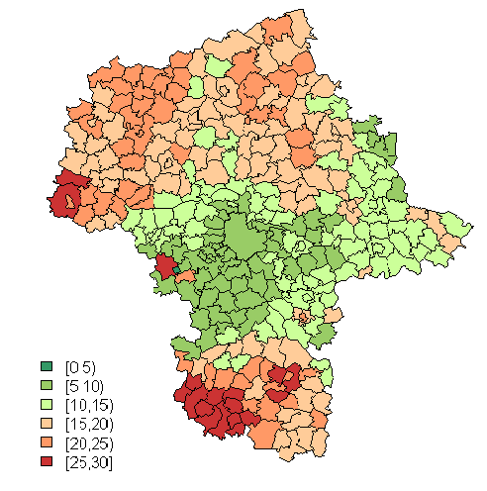
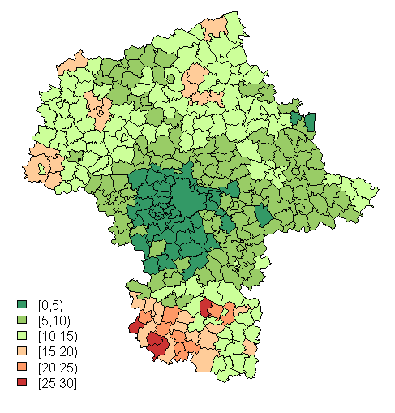
Moran scattererplot – example (1)
Let’s compare two periods
Method for spatial data:
Observed variable plotted on map for two (or more) time periods
Proper number of bins and colors from palette selected
Hypotheses:
Is the spatial distribution of examined variable stable over time?
What is the trend over time?
Problem:
- Poor comparisons due to scale changes
Unemployment rate
2003
2015

Slide 18
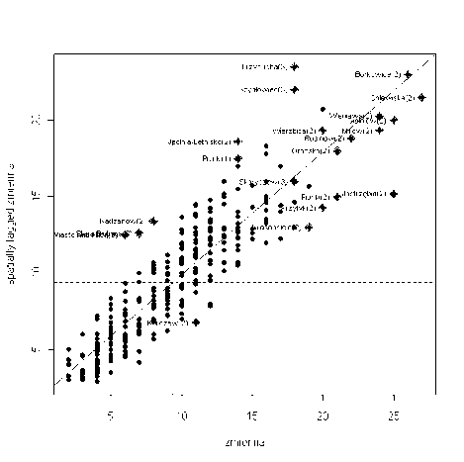
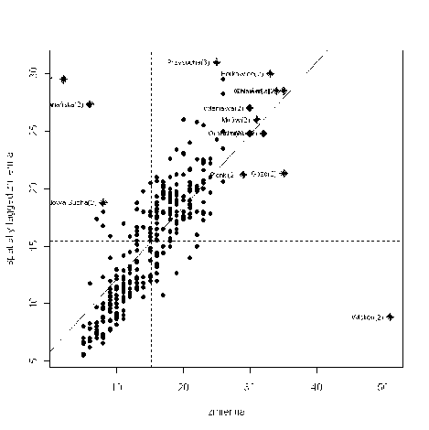
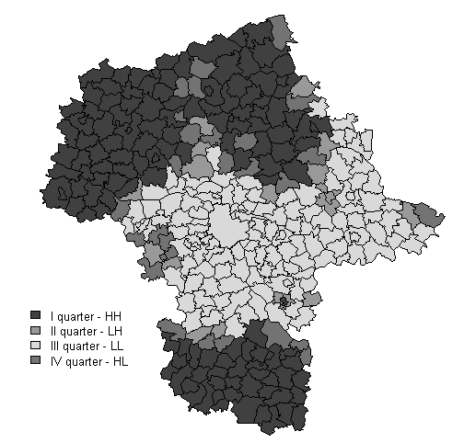
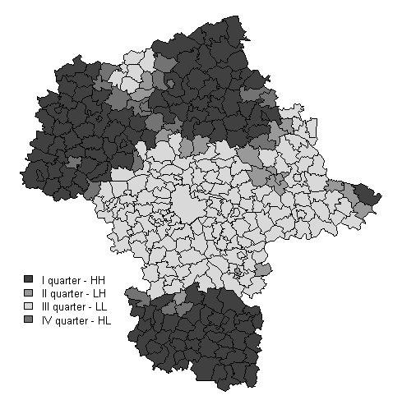
Moran scattererplot – example (2)
Using Moran Scatterplot earses the scale of phenomon – we stay with patial pattern only
2003
2015
We can see the structural changes in regions.

Slide 19
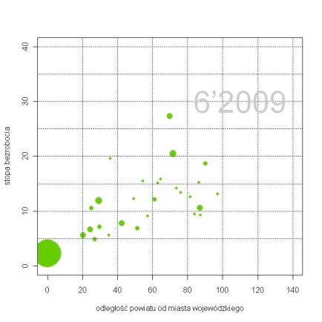
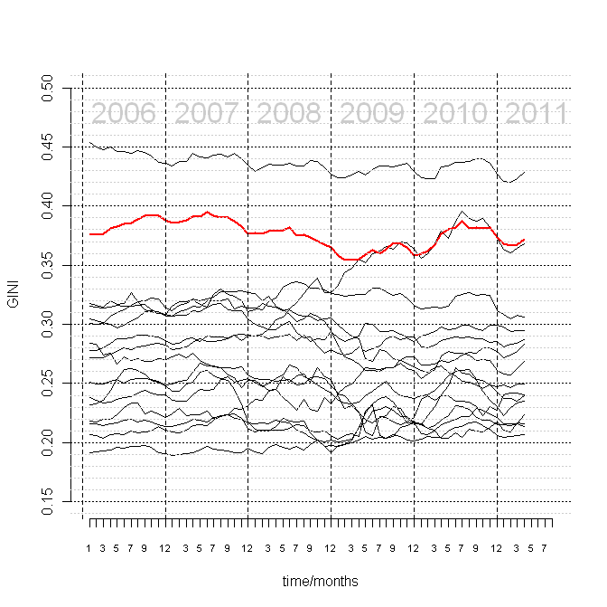
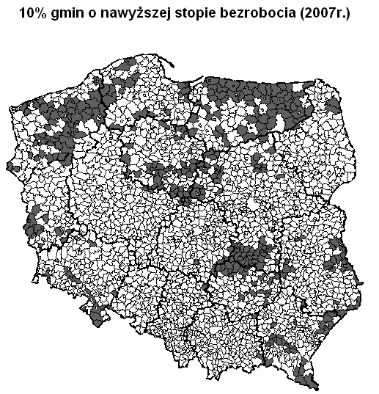
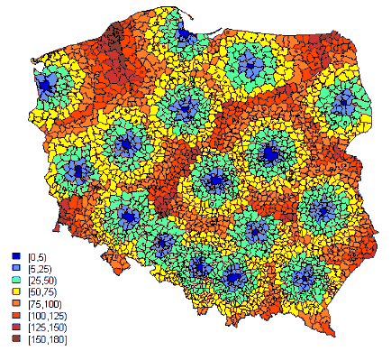
What else we can do with spatial data to get new information? (1)
Except Moran statistics (and other ESDA stats) one can explore:
relation of phenomenon (y) to distance (x)
cointegration of time series data for each region
maps of extreme 10% of values
phenomenon in relation to core-periphery pattern

Slide 20

What else we can do with spatial data to get new information? (2)
Distance-dependent unemployment
Gini of unemployed persons in NUTS2 regions

Slide 21
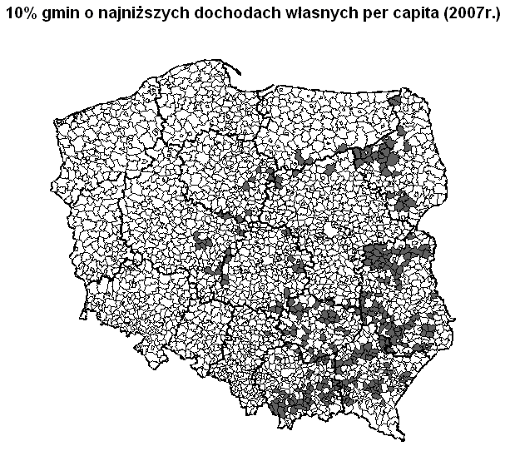
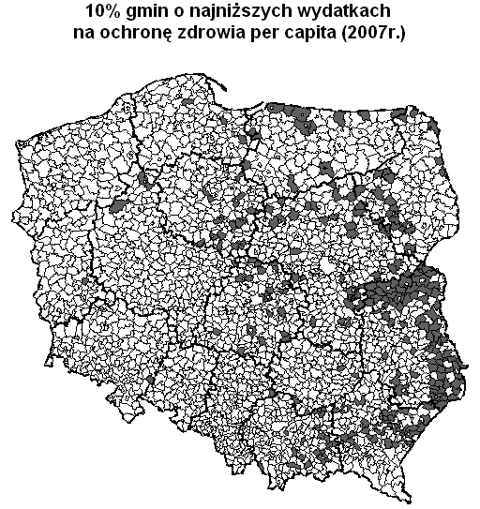
What else we can do with spatial data to get new information? (3)
Unemployment rate
Own revenues per capita
Health care system spendigs per capita

Slide 22
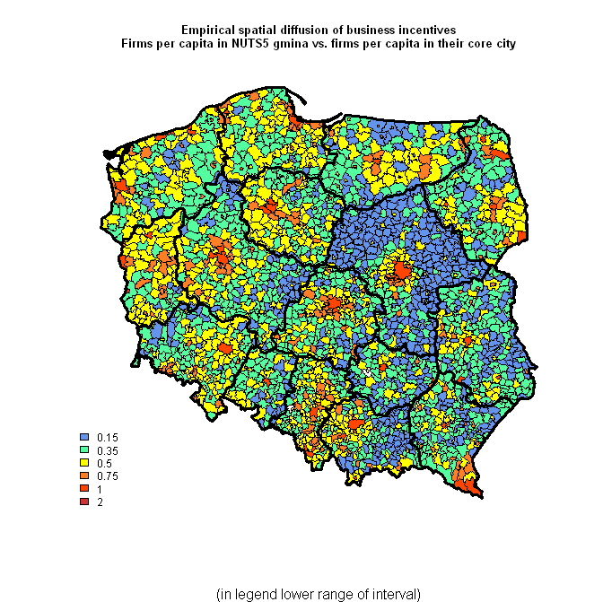
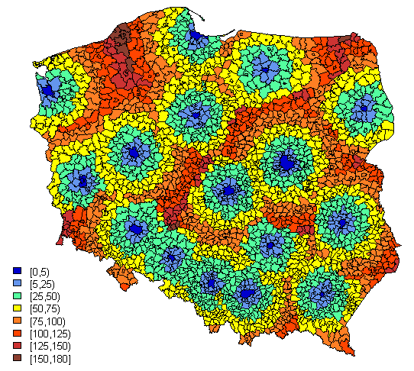
What else we can do with spatial data to get new information? (4)
Business units per capita
Distance between NUTS5 units and core city
?

